Slide 1
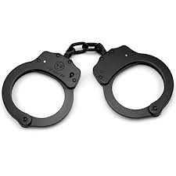
HOWDY!

Slide 2

Take a tip from OkCupid
(3.5 million users)
Data analysis suggests that men who begin their message with “howdy” have a 40% higher success rate than those who begin with “hi.”
Q: Why does this happen? A:It isn’t trite.
(The best include “how’s it going?”)

Slide 3

Do something “ODD”
Neurobiologists Dr. Nico Bunzeck and Dr. Emrah Duzel conducted the “Oddball Experiments” wherein they showed people a series of images and scanned their brains at the same time with fMRI. Most images were common faces and scenes, but some were odd.
The oddball images activated the areas of the brain for learning and memory.
The oddball images activated areas that release dopamine, feel good!
The oddball images activated a desire to explore more.

Slide 4
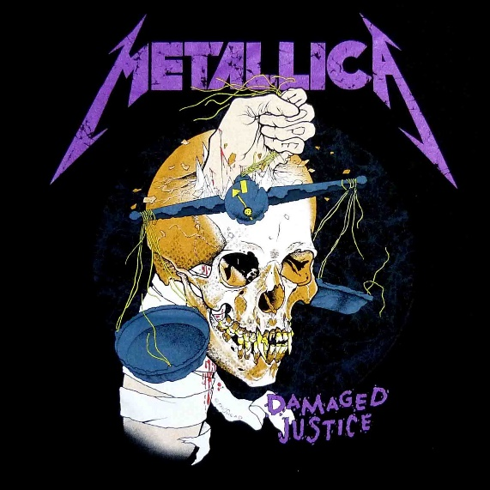
Here’s another tip from OkCupid.
Bring up specific interests. Generic bores.
“I’m a vegetarian.”
“I LOVE Metallica.”
“My name means “guardian of wealth.”
“TSA took the handcuffs from my suitcase.”

Slide 5
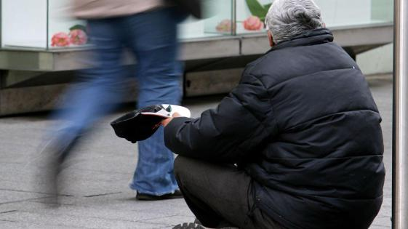
Specific works.
Researchers hired actors to stand on a corner and ask either:
Can you spare any change?
Can you spare a quarter?
Can you spare 37 cents?
#1 – 44% of people gave
#2 – 64% of people gave
#3 – 75% of people gave

Slide 6
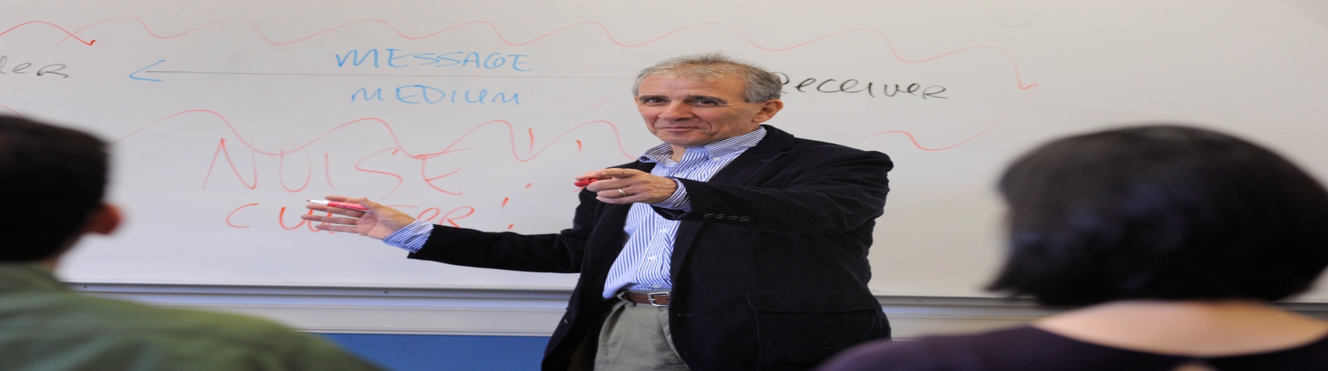
What works best?
I’m a teacher.
I work with graduate students and business people.
I have taught people from Mexico, India, China, Japan at CMU for over 25 years and in companies like Cognizant and Cinepolis.

Slide 7

Remember “Rapid Cognition.”

Slide 8

It’s all stories.

Slide 9
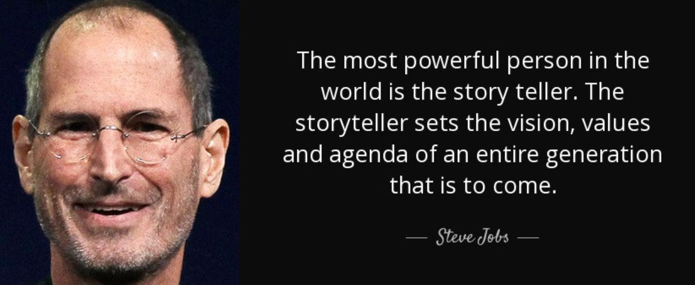
What do the experts say about storytelling?

Slide 10
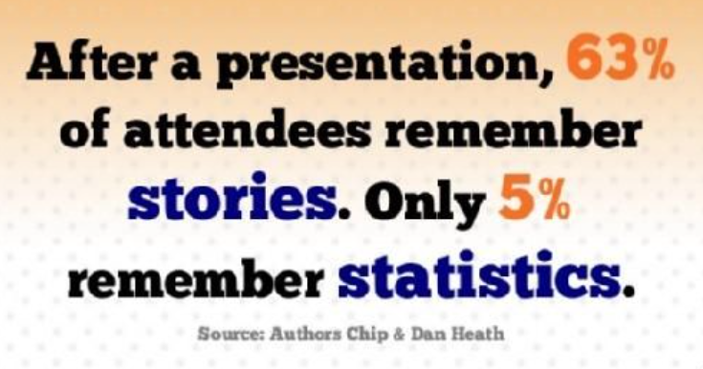

Slide 11

“Since motor actions enhance memory (enactment effect), it seems reasonable to expect that gesturing may also affect memory encoding and retrieval. Supporting this notion, a number of studies have found that memory is enhanced in participants who observe a speaker who is also gesturing compared to observing a speaker who is not gesturing….(e.g., Thompson, 1995; Kelly et al., 1999).
“Using actions to enhance memory: effects of enactment, gestures, and exercise on human memory.” Christopher R. Madan and Anthony Singhal

Slide 12
